Slide 1
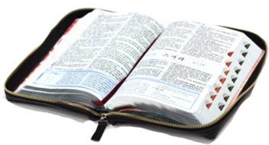
There's a dear and precious book
1 There's a dear and precious book, Tho' it's worn and faded now, Which recalls the happy days of long ago; When I stood at mother's knee, With her hand upon my brow, And I heard her voice in gentle tones and low.
Chorus: Blessed book, precious book, On thy dear old tear-stained leaves I love to look; Thou art sweet day by day, As I walk the narrow way That leads at last to that bright home above.
2 There she read of Jesus' love, As he blest the children dear, How he suffered, bled and died upon the tree; Of his heavy load of care, Then she dried my flowing tear With her kisses as she said it was for me.
3 Well, those days are past and gone, But their mem'ry lingers still, And the dear old Book each day has been my guide; And I seek to do his will, As my mother taught me then, And ever in my heart his words abide.

