Slide 1
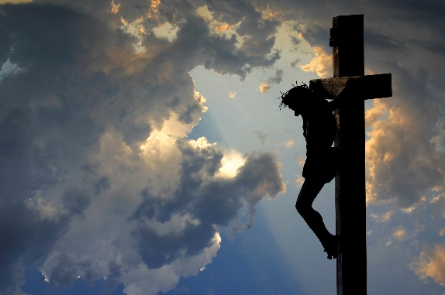
I Love to Tell the Story
1. I love to tell the story of unseen things above, Of Jesus and His glory, of Jesus and His love. I love to tell the story, because I know ’tis true; It satisfies my longings as nothing else can do.
2. I love to tell the story; more wonderful it seems Than all the golden fancies of all our golden dreams. I love to tell the story, it did so much for me; And that is just the reason I tell it now to thee.
3. I love to tell the story, for those who know it best Seem hungering and thirsting to hear it like the rest. And when, in scenes of glory, I sing the new, new song, ’Twill be the old, old story that I have loved so long.
Refrain
I love to tell the story, ’twill be my theme in glory, To tell the old, old story of Jesus and His love.

