Slide 1
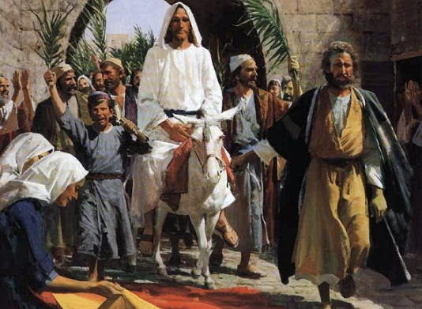
Hosanna, Loud Hosanna
1. Hosanna, loud hosanna, the little children sang, through pillared court and temple the lovely anthem rang. To Jesus, who had blessed them held close against his chest, the children sang their praises, the simplest and the best. 2. "Hosanna in the highest!" that ancient song we sing, for Christ is our Redeemer, the Lord of heaven our King. O may we ever praise him with heart and life and voice, and in his blissful presence eternally rejoice!

